Slide 1
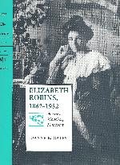
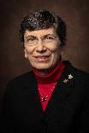
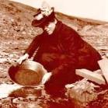
Facets of Feminist Biography
Dr. Joanne E. Gates
Professor Emerita, English
jgates@jsu.edu
Title Slide 1

Slide 2
Creative Biography
Defining myself as a creative biographer:
Even my dissertation has components of a scripted play
See my “Janet Malcolm and Me” paper at JSU Digital Commons, Faculty Presentations
I see Life Writing as Acts of Interpretation and Dramatization, with a Theater Degree and an early conference paper on the one-woman show. For my biography, I invented scenes as “Glue” to hold the narrative together.
Playwriting: Hedda and Hilda and I. Other scripts (enumerated later)
Innate, yet grounded in theory?

Slide 3
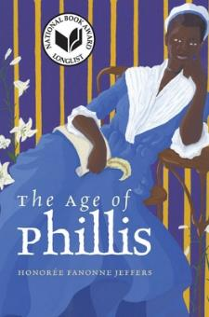
Collection of poems that imagines more of the life and times
Wheatley (or Wheatley Peters) published her book in England, 1773.
An online lecture connects Hartman
https://www.youtube.com/watch?v=9vAryUbzsTM&t=3394s
Slide 3

Slide 4
Honorée Fanonne Jeffers: The Age of Phillis Jeffers credits in an online talk (not in her bibliography) Saidiya Hartman’s concept of “Critical Fabulation”
Saidiya Hartman
Honorée Fanonne Jeffers
Columbia U
University of Oklahoma
W.W. Norton​
Wesleyan U. Press​
2020
Paperback cover

Slide 5
Original article by Hartman is: “Venus in Two Acts,” in Small Axe
https://read.dukeupress.edu/small-axe/article/12/2/1/32332/Venus-in-Two-Acts
Slide 5

Slide 6
Hartman explains:
“The intention here isn’t anything as miraculous as recovering the lives of the enslaved or redeeming the dead, but rather laboring to paint as full a picture of the lives of the captives as possible. This double gesture can be described as straining against the limits of the archive to write a cultural history of the captive, and, at the same time, enacting the impossibility of representing the lives of the captives precisely through the process of narration.”
--Hartman, “Venus in Two Acts,” p. 11

Slide 7
Critical Fabulations is also a book by Daniela Rosner Subtitle: Reworking the Methods and Margins of Design. Blends the Real with Imaginary.
Rosner talk:
Rosner credits Hartman for what it means to “Narrate the Impossible,” especially with slave trade.
“Venus in Two Acts” is Hartman’s study which mentions CF: Writing against the Archive.
Alternative to what’s inherited (as a computer program).
Where else is Critical Fabulation applied?
Tell a story
Rosner is interested in NASA women telling of “Core Memory”; how it might be analogous to quilting.

Slide 8
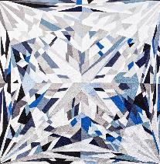
Jeffers stresses that she stays in the time period. Other poets inject personal context.
For instance, Susan Howe’s My Emily Dickinson
Slide 8

Slide 9
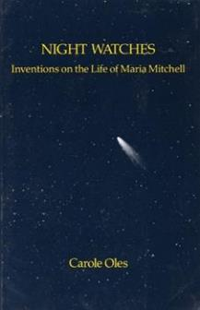
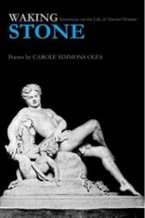
Two volumes by poet Carole Simmons Oles
Waking Stone: Inventions on the Life of Harriet Hosmer
and Night Watches: Inventions on the Life of Maria Mitchell
Slide 9

Slide 10
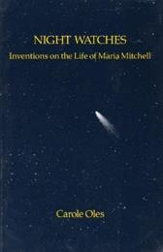
In each of Oles’s volumes,
Women’s Lives
The poet injects contemporary context, a meditation on private life.
Oles connects stardom of Maria Mitchell, the Vassar College astronomer, to Marilyn Monroe.
Her facets of Hosmer’s life and artistic output come alive when she connects Hosmer’s work in stone to her own father’s career; she names her sibling blue baby brother and mentions Hatty’s siblings who died as infants.

Slide 11
[Indirect connections, Oles to Robins]
[I discovered Oles’s Maria Mitchell volume as part of my 50th Reunion weekend at Vassar College. The music department presented a soprano-piano adaptation of several Oles poems. ER’s father was hopeful he could send his daughter to Vassar. ER stays at Vassar in 1942.
Harriet Hosmer’s career as sculptor was sponsored in part by Wayman Crow, a distant cousin of Elizabeth’s mother, Hannah Maria Crow Robins, who also sponsored the actress Charlotte Cushman. Robins visited the St. Louis Crows, while on tour in America. Robins would have known of Charlotte Cushman’s connection to Wayman Crow’s daughter Emma Crow and Emma’s marriage to Cushman’s nephew. A different Crow cousin, Lloyd Tevis, was more active in funding ER’s early career. ] –slide added after presentation.

Slide 12
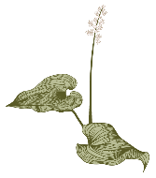
Dramatized Biography
There are innumerable other known plays about women:
Virginia, a Play by Edna O’Brien
Emilie: The Marquise du Chatalet Defends Her Life Tonight (play by Lauren Gunderson).
Also:
Poets Rita Dove (Sonata Mulattica about the violinist, George Polgreen Bridgerton) and Ashley M. Jones’s cluster on Harriet Tubman.
Women’s Lives
A later slide enumerates my poems, plays, and dramaturgy projects (adapted scripts)

Slide 13
Invented facts: What is considered transgression?
Hermione Lee takes issue with Edmund Morris’ biography of Reagan, Dutch.
Stephen Oates’s class in writing biography taught the lesson: “Do not Invent!”
Yet he displayed his own creativity in taking up the format of telling the pre-civil war years as a series of first-person narratives:
The Approaching Fury, The Whirlwind of War.

Slide 14
My presentation in 2021 did point out the lack of good attributions.
For the SAMLA virtual conference,
“Novelizing the Feminist Biography: What are the Ethics of Sourcing?,”
I took issue with Paula McLain, Marie Benedict, et al., for insufficiently crediting their rich biographical sources such as Mary S. Lovell on Beryl Markham and Heidi Ardizzone on Belle da Costa Greene.
See the JSU Digital Commons bibliography and PowerPoint record of this presentation, https://digitalcommons.jsu.edu/fac_pres/24/

Slide 15
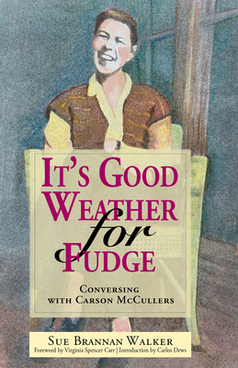
Sue Walker on Carson McCullers: She wrote her dissertation on CMcC, then composed a direct-address poem, delivered at a conference in Columbus GA It’s Good Weather for Fudge: Conversing with Carson McCullers
Foreword by Virginia Spencer Carr New South Books, 2003
Slide 14

Slide 16
Oles also uses direct address Jeffers uses first-person a great deal.
Each of these poetic collections have / had been in part performed
Slide 15

Slide 17
Like Sue Walker, I have delivered direct address talks to my subject Elizabeth Robins: A Life in Letters
Ohio State presentation was also in the form of “Dear Elizabeth Robins”
First Hedda, First Hilda, and Hilda Harnessed to a Purpose

Slide 18
Six of Oles’s poems were adapted for piano and soprano Performed in Summer 2022: Maria Mitchell at Vassar
Even though the sung presentation was difficult to fully process, the idea of exploring adaptation of short pieces engaged me, as did essential history of early Vassar and achievements of 19th century women.

Slide 19
Some of the Age of Phillis poems have been dramatized
YouTube version at Revolutionary Spaces
Discussion, with presentations of selected poems, mostly as monologues
(links on next slide)
Slide 18

Slide 20
Age of Phillis by Jeffers has sections adapted for viewing on line at Revolutionary Spaces
filmed in historic Boston
Imagining the Age of Phillis, 17-minute film, https://www.youtube.com/watch?v=Oc1y6sIRgc4
Phillis Wheatley Peters and African Lineage and Kinship in The Age of Phillis
Presentation and some clips from above, with Jeffers, https://www.youtube.com/watch?v=FlI7bX_HCOc

Slide 21
A creative project such as Jeffers on Wheatley allows for fragmented pieces of a self
I plan to apply this approach to capture the broad literary and cultural cast of characters in the life of Robins
Slide 20

Slide 22
There may be two separate one-woman shows doing Wheatley. Jeffers mentions one Wheatley performer and, in searching, a different one emerged.
Slide 21

Slide 23
Next slide will revisit a previous slide
Jeffers with credit to Hartman
Slide 22

Slide 24
Honorée Fanonne Jeffers: The Age of Phillis Jeffers credits in an online talk (not in her bibliography) Saidiya Hartman’s concept of “Critical Fabulation”
Honorée Fanonne Jeffers
Saidiya Hartman
University of Oklahoma
Columbia U
W.W. Norton​
Wesleyan U. Press​
2020
Paperback cover

Slide 25
Four Book Covers have Photographs of Elizabeth Robins
Alaska Klondike
Diary, 1900
Biography by
Angela John
University of Alaska Press
Leslie Hall​
U. of Alabama Press​
now in paper
Staging a Life
ER as Hedda Gabler

Slide 26
In many cases, the projects come to you.
Papers I have Previously Presented at conferences:
Originally these were going to be a printed collection. Instead, I am submitting to Digital Commons, Faculty, Presentations.
Sometimes the conference theme shaped the work.
As with traditional research, pieces of the papers have sometimes been repurposed from my dissertation.
My Work on the Robins Web:
Various obligations of being a principal biographer
Includes more public domain texts, more links
Updated bibliography
Invitation to participate in anthologies, and a podcast series:

Slide 27
My original plays and directing and/or dramaturgy experiments.
Adapted:
The Belle of Amherst (Emily Dickinson one-woman show) to class performance at Belvoir Terrace Fine Arts Center.
Also at Belvoir, a different all-female class performed sections of Joan Baez’s Daybreak, interspersed with her music.
At U Mass Amherst, a staged reading of Virginia Woolf’s The Waves. (Sarah Ruhl’s Orlando is upcoming.)
Earlier Feminist biography experiments by Joanne E. Gates
Authored:
Aphra Behn
Beatrix Potter
Fanny Kemble
Hedda and Hilda and I

Slide 28
My poetic chapbook, Menopause: It’s Not Just Me
From experiments with the Scribblers Writing Group
Profiled well-known women from literature, history, culture, the arts –at a certain moment in life.
Some poems were submitted to contests, including poetry journals and Alabama Poets Association
Features:
Feminist biography experiments
(assorted poems)
Dale Evans
Georgia O’Keeffe
Isabella Stewart Gardner
Lavinia Dickinson
Carrie A. Nation and her resemblance to “Grumpy Cat”

Slide 29
Placing Elizabeth Robins
The theatre world
Women’s Suffrage
American career: James O’Neill, Edwin Booth, Boston Museum
Ibsen performances: First Hedda, Hilda, Asta, Ella.
Bernard Shaw, Oscar Wilde. Mrs. Patrick Campbell, Archer.
Promoted National Theatre
Wrote plays including Votes for Women, the newly published My Little Sister.
Autobiographical reminiscenses include Ibsen and the Actress, Theatre and Friendship (with Henry James), Both Sides of the Curtain
Novels and themes
Pethick-Lawrences, the Pankhursts.
Lady Constance Lytton.
In America: Alice Paul, Carrie Chapman Catt, Drier and Drier Robins.
Called upon to speak or write on behalf of the Cause.
The Convert, Way Stations, Christabel
First 3 novels and short stories published pseudonymously, C. E. Raimond.
Alaska travel 1900. Connected to William Stead.
Knew Leonard and Virginia Woolf.
Asked to “blurb” Edith Wharton.
Knew Alice Duer Miller, Mrs. Humphrey Ward.
Promoted the work of Gertrude Bell, Lady Wortly Montagu.

Slide 30
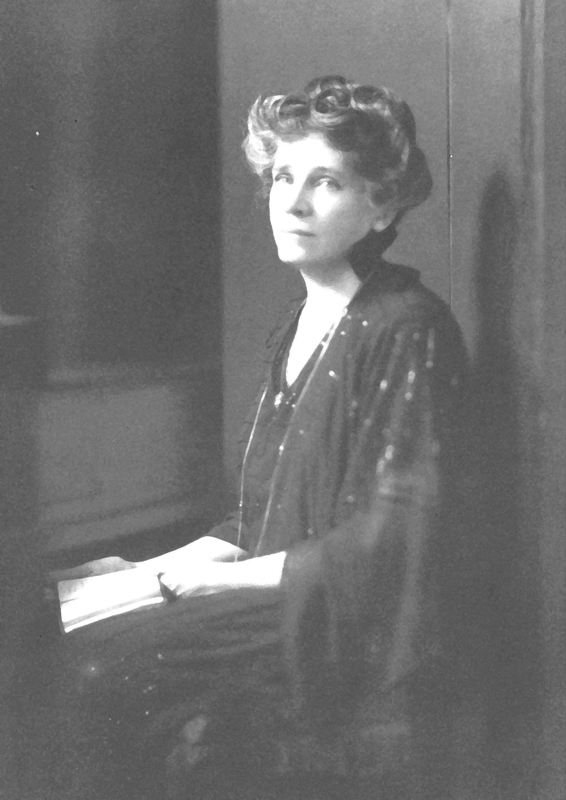
Her longest visit to the US, 1940-1945. This shadow of original photo is circa 1925.
A new approach developed since mid summer 2022:
A projected novel or young adult novel of Robins
Credit: MDR papers, U of Florida, Gainesville
Slide 29

Slide 31
Notes towards a novel
I am seriously thinking about setting a novel about Elizabeth Robins at Vassar, 1942, when ER is turning 80. Possibly a young adult read. The epilogue to my biography is set at Vassar College Alumnae House, where I knew she was, thanks to correspondence. For that scene, I merely tried to convey a sense of "how to capture the real you." I imagined the secretary that her brother said he would pay for and "wrote in" her double, or my own biographer self. With a different purpose, I can get at how the war in Europe has displaced Robins. In WWI, she did volunteer work in a London hospital (as Henry James did) but in 1940, as a non-citizen, was forced to leave England. Another place she stayed, after Vassar, was the Princeton Inn, now Forbes College, where I myself stayed summer of 88.

Slide 32
notes towards a novel, 2
In 1942, the Japanese bomb Dutch Harbor Alaska, giving ER the chance to reminisce about her Alaska travel. The Germans destroy Lidice (and Edna St. Vincent Millay writes the poem, The Murder of Lidice), Grace Hopper is deciding to give up her professorship to work for the Navy. Hallie Flanagan gets offered a position at Smith (but ER meets her, learns much about her National Theatre, an interest they share). Maybe the "secretary" has roots in Poughkeepsie family that go back.
At any rate, ER can get into a discussion of the historical Vassar, Maria Mitchell and Dr. Alida Avery, etc. ER’s father wanted to send her there; she saw the family need and wanted to be an actress to help support the younger siblings. Dr. Avery promoted good health through hydration, which no doubt interested ER, and Avery later did work in Colorado for suffrage. Of course, the "graveyard meeting of the suffragists" (organized in 1908 by Inez Milholland) would interest Robins. Somewhere near the time she is at Vassar, she meets Eleanor Roosevelt.

Slide 33
notes towards a novel, 3
But I need a plot! Rather than mere chats about ER’s long career and accomplishments, interspersed with her learning about the history of Vassar, I will be inventing some intrigue that is related to the rise of Nazi sympathizers among British and American right wingers.
One neat aspect of this is to have the younger secretary use ER’s WWI spy novel (The Messenger) to help her figure out what might be going on in the vicinity of Hyde Park and Val Kill. Research on this has taken me way off course, but I am learning much about women who cracked codes (Elizabeth Smith Friedman). On the same day that I read of the pilot Laura Ingalls, arrested for dropping Nazi leaflets while flying over the White House, Rachel Maddow, later that evening, mentioned her to promote her new podcast.

Slide 34
novel, 4
Of course, this dovetails with the ‘now’ of Russia’s illegitimate war in Ukraine.
Rise of Nationalisms that are authoritarian, militant, and oppressive
The safety of Atlantic crossings impeded by belligerent actions
Women’s roles in society
Eleanor Roosevelt as an anchor to women as regular component of political life. (Her “My Day” columns and correspondence are online.)

Slide 35
To Summarize
Trust Creative Instincts
Find other models
Continue to explore
Stretch the boundaries of traditional format.
Obtain degree criteria and participate in the profession
After creativity comes the rationalization.
See where there are examples of creativity applied to imagining the life.
As I stated in a conference paper a year ago, there are novelists who steal too much from biographers, giving only minimal credit.
Where relevant, apply theoretical categorizations and justifications.
Short poems will focus on moments that are can highlight the variety and intensity of her life and relations. Some will inject my own life experiences.
Novel will keep me busy and engaged in professional work.
Dramatizing the already scripted is another future endeavor.

Slide 36
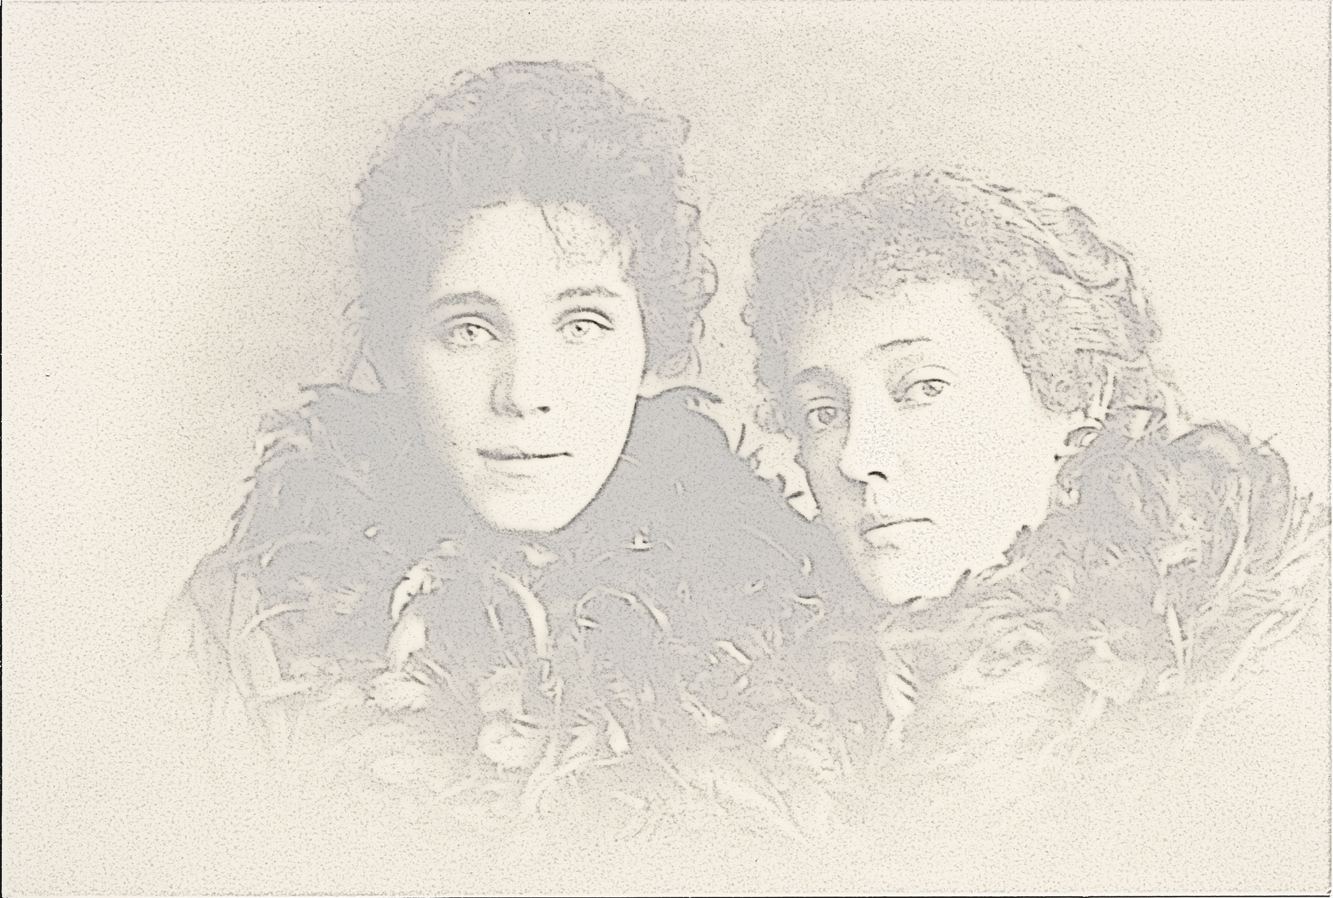
Robins and Marion Lea as Hedda and Thea, 1891 Shadow image: Original at Fales Library, NYU: ER Papers
Dr. Joanne E. Gates
Project Director
Elizabeth Robins Web
https://www.jsu.edu/robinsweb
Slide 35

Slide 37
Facets of Feminist Biography
Dr. Joanne E. Gates
Professor Emerita, English
jgates@jsu.edu
End Slide 36

Slide 38
Addenda: original abstract and program description
Presenter: Joanne Gates, Professor Emerita, English
This is a brief overview of how I continue to be engaged with research on Elizabeth Robins in the context of other women writers, post retirement. The presentation's subtitle might be phrased as "From my study of the one-woman show in graduate school to creative and poetic approaches as emerita researcher." I maintain the Elizabeth Robins Web at JSU and have presented two papers (virtually at recent SAMLA conferences) since leaving the classroom. I am particularly interested in the format of several poetry collections that piece together a life of a prominent woman with clear autobiographical content from the author. Carole Oles has authored "Inventions on the Life of Harriet Hosmer" and "Inventions on the Life of Maria Mitchell.“ Honoree Fanonne Jeffers produced the impressive "The Age of Phillis" based on her research on Phillis Wheatley. Jeffers credits in an online talk (not in her bibliography) Saidiya Hartman’s concept of “Critical Fabulation” This notion I think applies as well to Oles and the short creative pieces I am planning for my further work on Robins. In addition, I briefly share some ideas on how I have informally outlined an idea for a novel based on accomplishments of Elizabeth Robins, partly situated at the Vassar Alumnae House, 1942, where my biography’s epilogue is set.
Short presentation in B-01 at 3:30 – 3:45, November 3, 2022, Merrill Hall
Jacksonville State University’s Faculty Research Symposium, Jacksonville AL.

